Slide 1

THREE BODY PROBLEM

Slide 2
The Three Body Problem is about finding out the characteristics of motion of three particles when the only forces acting are for example, mutual gravitational pull. This is a subset on the n-body problem which talks about a finite number (n) of bodies moving and interacting in a similar way. The solutions greatly depend on the initial positions and velocity conditions of the particles, and closed form solutions are available only in certain cases. We have tried to attempt this problem iteratively.
Since there is no general analytical solution that takes care of all initial conditions, iterative solutions give the much required insight into the subsequent paths of the three particles which depend heavily on the initial conditions. Generally, the particles take up non-repeating paths unless some special initial conditions are used. In fact, finding new solutions to this problem comes under research, and many researchers in the world are currently working on such families of solutions.

Slide 3
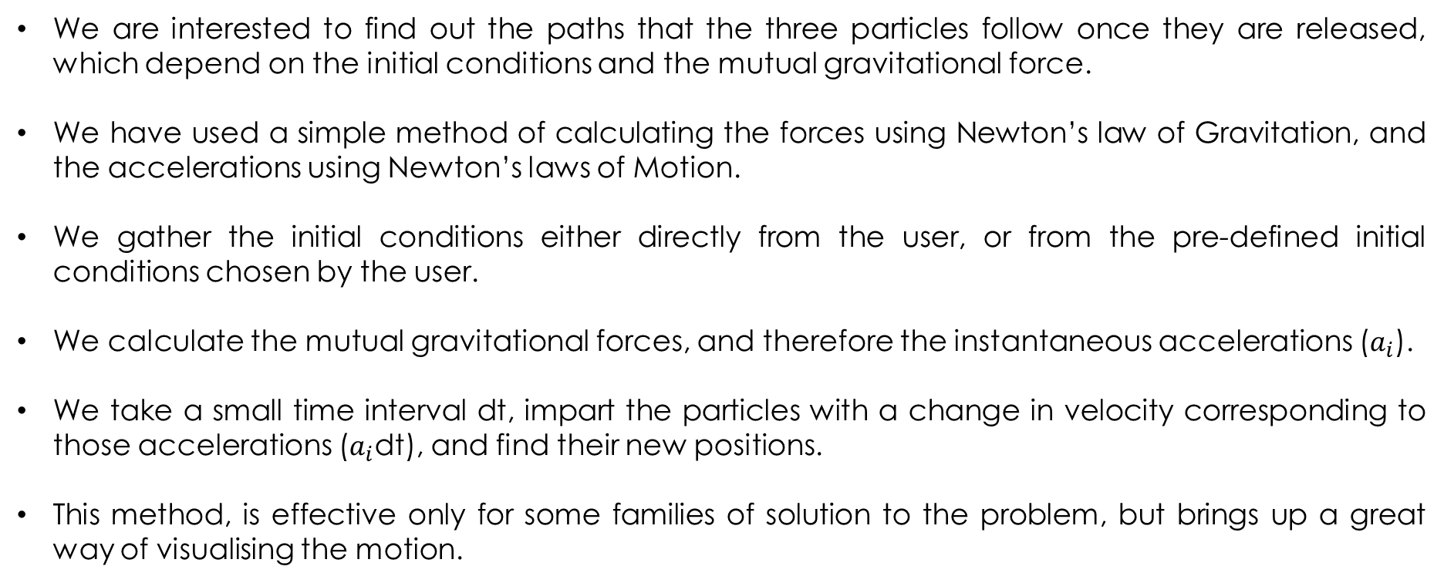
We are interested to find out the paths that the three particles follow once they are released, which depend on the initial conditions and the mutual gravitational force.
We have used a simple method of calculating the forces using Newton’s law of Gravitation, and the accelerations using Newton’s laws of Motion.
We gather the initial conditions either directly from the user, or from the pre-defined initial conditions chosen by the user.
We calculate the mutual gravitational forces, and therefore the instantaneous accelerations ($a_{i}$).
We take a small time interval dt, impart the particles with a change in velocity corresponding to those accelerations ($a_{i}$dt), and find their new positions.
This method, is effective only for some families of solution to the problem, but brings up a great way of visualising the motion.

Slide 4
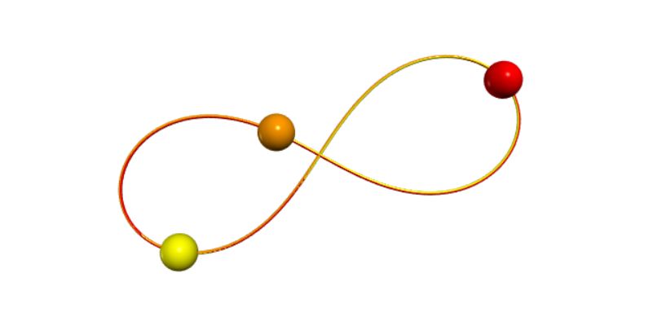
Our primary goal is to make a virtual lab which will help school and college students visualise the nature of the problem and appreciate it’s beauty.
Thus, we have represented the solutions in the form of animation. The particles trace their paths as they travel across the screen, which looks entertaining.
The virtual lab comes with basic theory and instructions for use, making it a nice go-to platform for students who have just started learning about this topic!!

Slide 5
Scope of Improvement: The problems we faced while debugging the code are:
The animation becomes slow after some time.
Due to accumulation of errors through the iterations, the particles divert a little bit from the path they should have followed, for some cases.
Using numerical techniques like RK4 might help us control these errors, which we plan to execute in the next semester as we want to make our final virtual lab as accurate as possible.
We are thankful to our mentors: Dr. Somnath Sarangi, and Dr. Anirban Mahato for guiding us in this regard. We also thank our faculty advisor Dr. Murshid Imam for providing us this opportunity.
THANK YOU

